Slide 1
Regression
Prepared by
Sajana Shakya

Slide 2
Definition:
It is statistical measure used to determine probable or average form of relationship between two or more variables. The objective of this analysis is to predict the value of unknown variable corresponding to the given value of another variable.

Slide 3
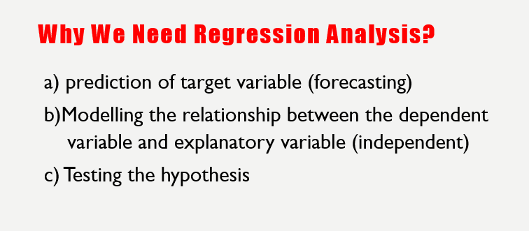

Slide 4
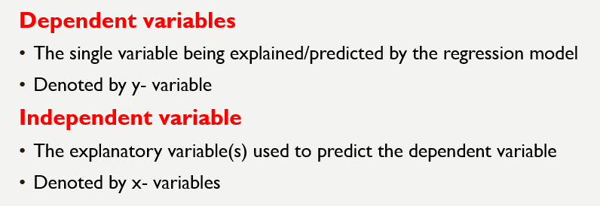

Slide 5
Two types of Regression:
1) Linear Regression
2) Non-linear Regression
Two types of Linear Regression:
1) Simple Regression
2) Multiple Regression

Slide 6
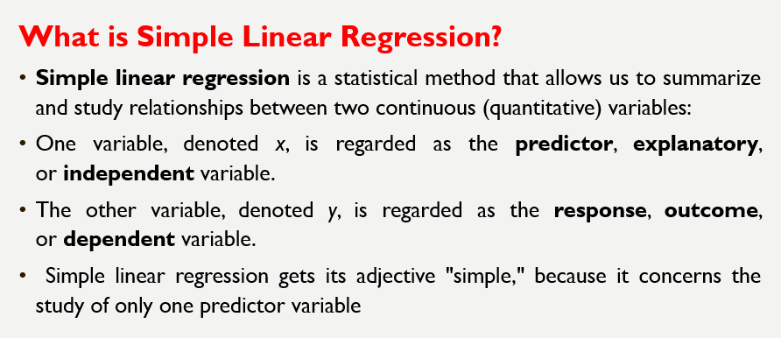

Slide 7
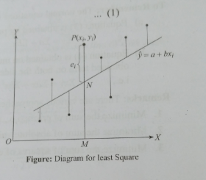
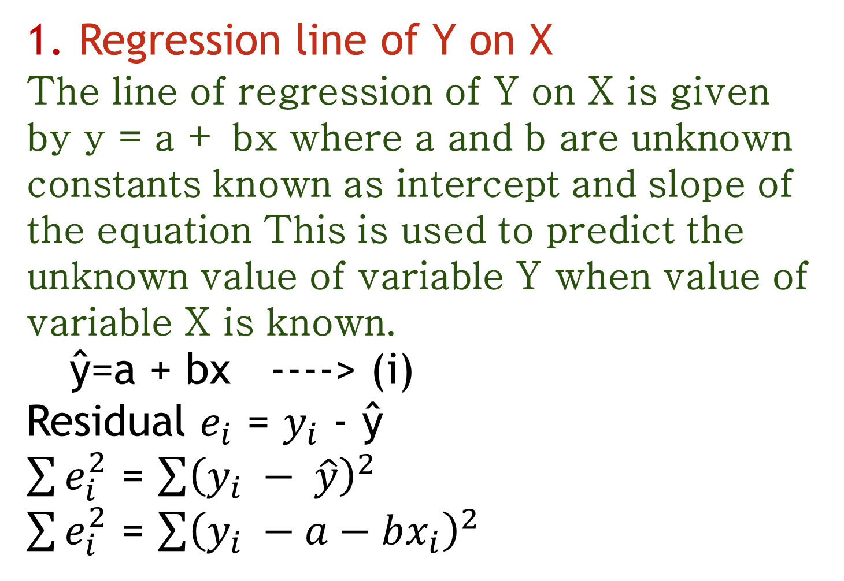
1. Regression line of Y on X
The line of regression of Y on X is given by y = a + bx where a and b are unknown constants known as intercept and slope of the equation This is used to predict the unknown value of variable Y when value of variable X is known. ŷ=a + bx ----> (i)
Residual $e_{i}$ = $y_{i}$ - ŷ
$\sum{e_{i}^{2}}$ = $\sum{{\left(y_{i} − \hat{y}\right)}^{2}}$
$\sum{e_{i}^{2}}$ = $\sum{{\left(y_{i} −a−bx_{i}\right)}^{2}}$
X | Y
- | -
- | -
- | -
- | -
- | -

Slide 8
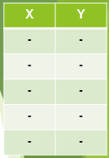

Slide 9
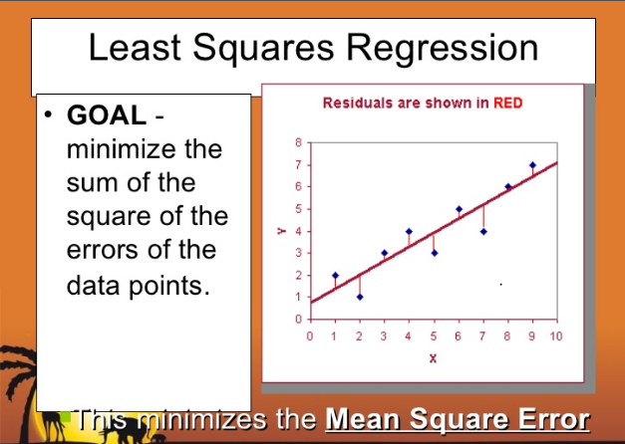

Slide 10
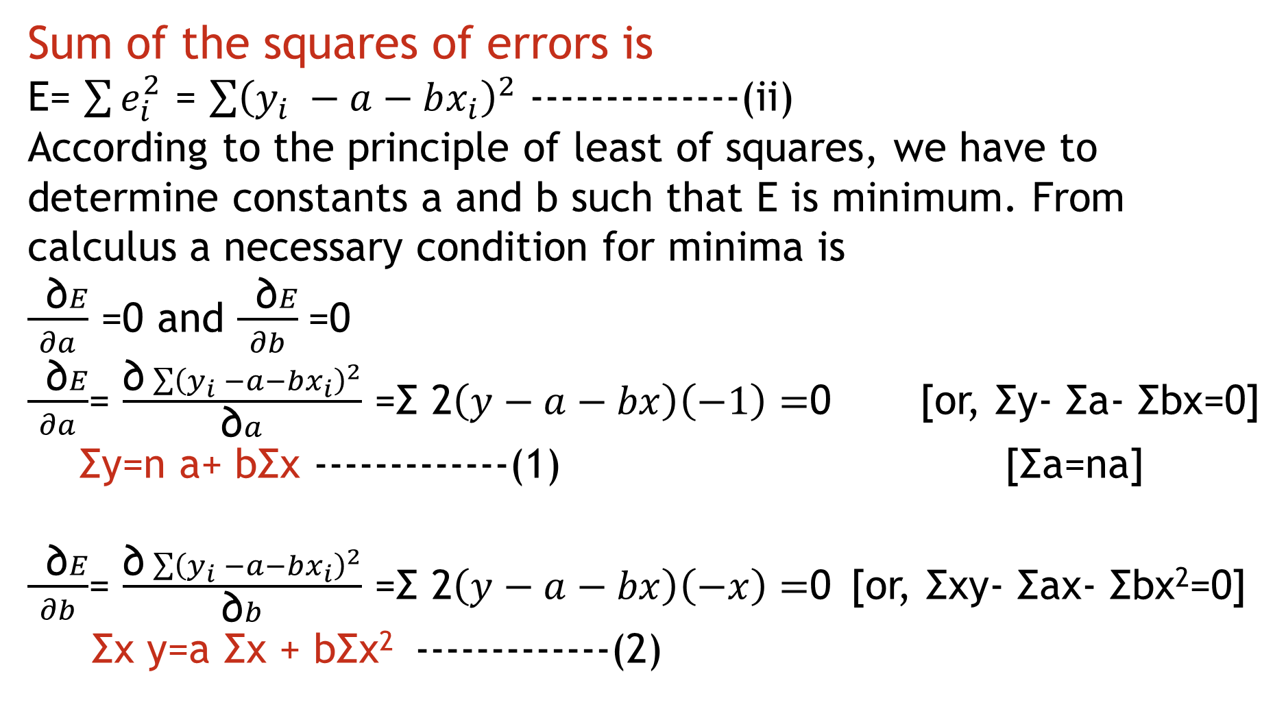
Sum of the squares of errors is
E= $\sum{e_{i}^{2}}$ = $\sum{{\left(y_{i} −a−bx_{i}\right)}^{2}}$ --------------(ii)
According to the principle of least of squares, we have to determine constants a and b such that E is minimum. From calculus a necessary condition for minima is
$\frac{ \text{∂}E}{∂a}$ =0 and $\frac{ \text{∂}E}{∂b}$=0
$\frac{ \text{∂}E}{∂a}$= $\frac{\text{∂}\sum{{\left(y_{i} −a−bx_{i}\right)}^{2}}}{\text{∂}a}$ =Σ 2$\left(y−a−bx\right)\left(−1\right)=$0 [or, Σy- Σa- Σbx=0]
Σy=n a+ bΣx -------------(1) [Σa=na]
$\frac{ \text{∂}E}{∂b}$= $\frac{\text{∂}\sum{{\left(y_{i} −a−bx_{i}\right)}^{2}}}{\text{∂}b}$ =Σ 2$\left(y−a−bx\right)\left(−x\right)=$0 [or, Σxy- Σax- Σbx²=0]
Σx y=a Σx + bΣx² -------------(2)

Slide 11
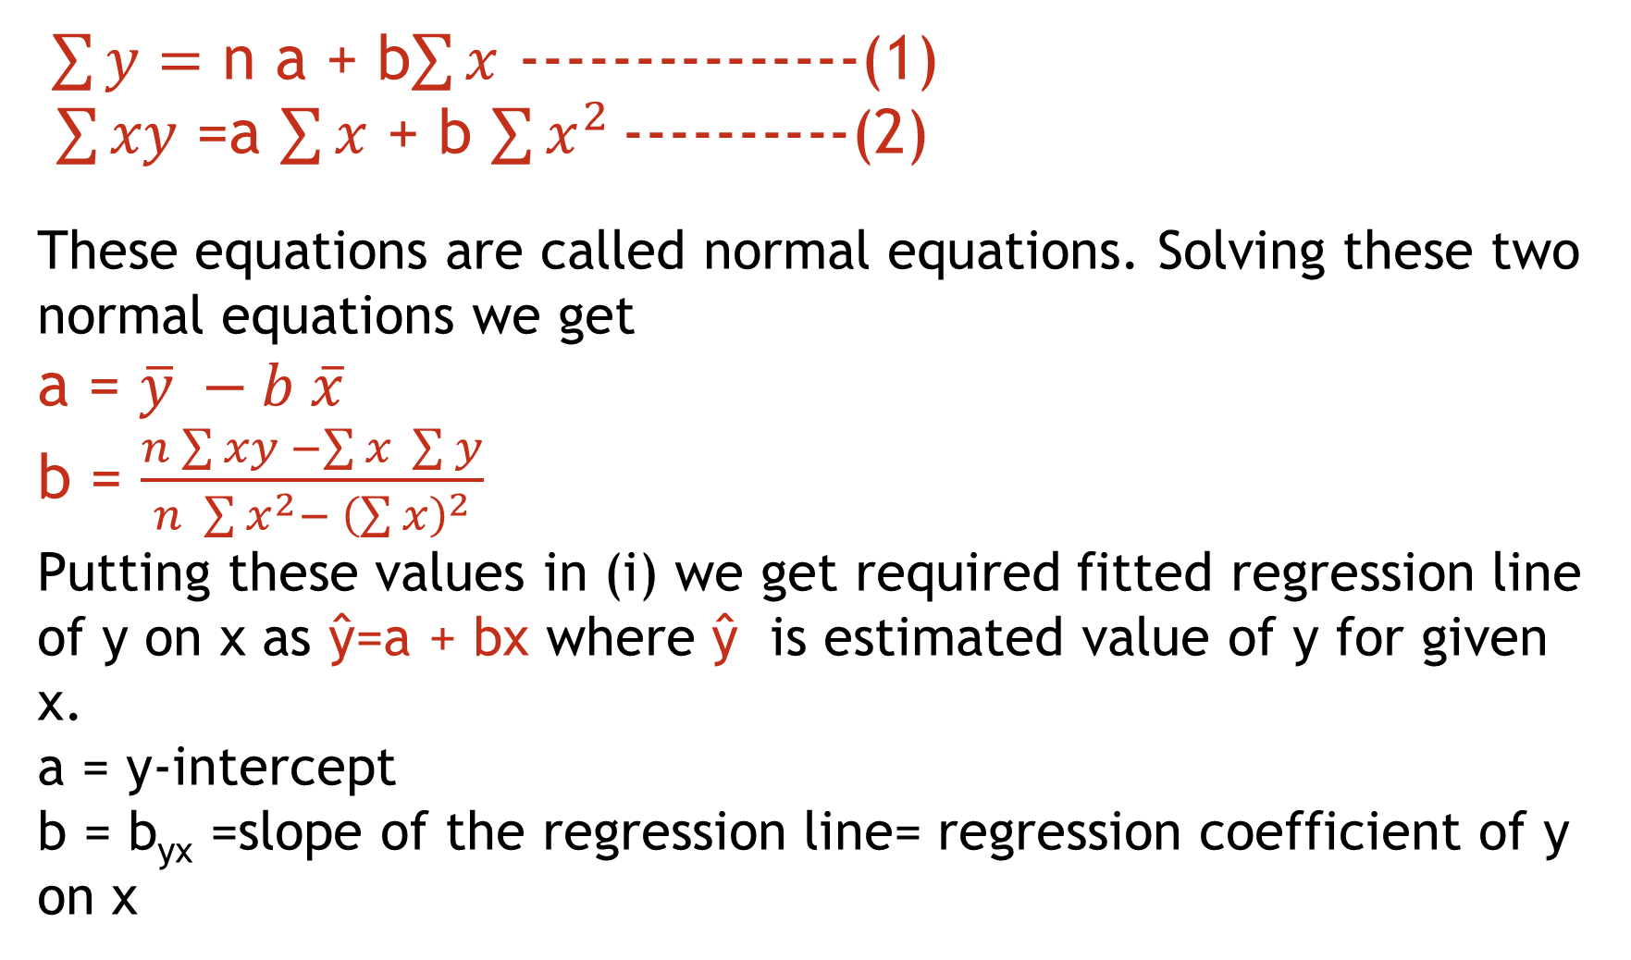
$\sum{y}=$ n a + b$\sum{x}$ ---------------(1)
$\sum{xy}$ =a $\sum{x}$ + b $\sum{x^{2}}$ ----------(2)
These equations are called normal equations. Solving these two normal equations we get a = $\overline{y} −b \overline{x}$ b = $\frac{n\sum{xy −\sum{x \sum{y}}}}{n \sum{x^{2}}− {\left(\sum{x}\right)}^{2}}$
Putting these values in (i) we get required fitted regression line of y on x as ŷ=a + bx where ŷ is estimated value of y for given x. a = y-intercept b = b_{yx} =slope of the regression line= regression coefficient of y on x

Slide 12
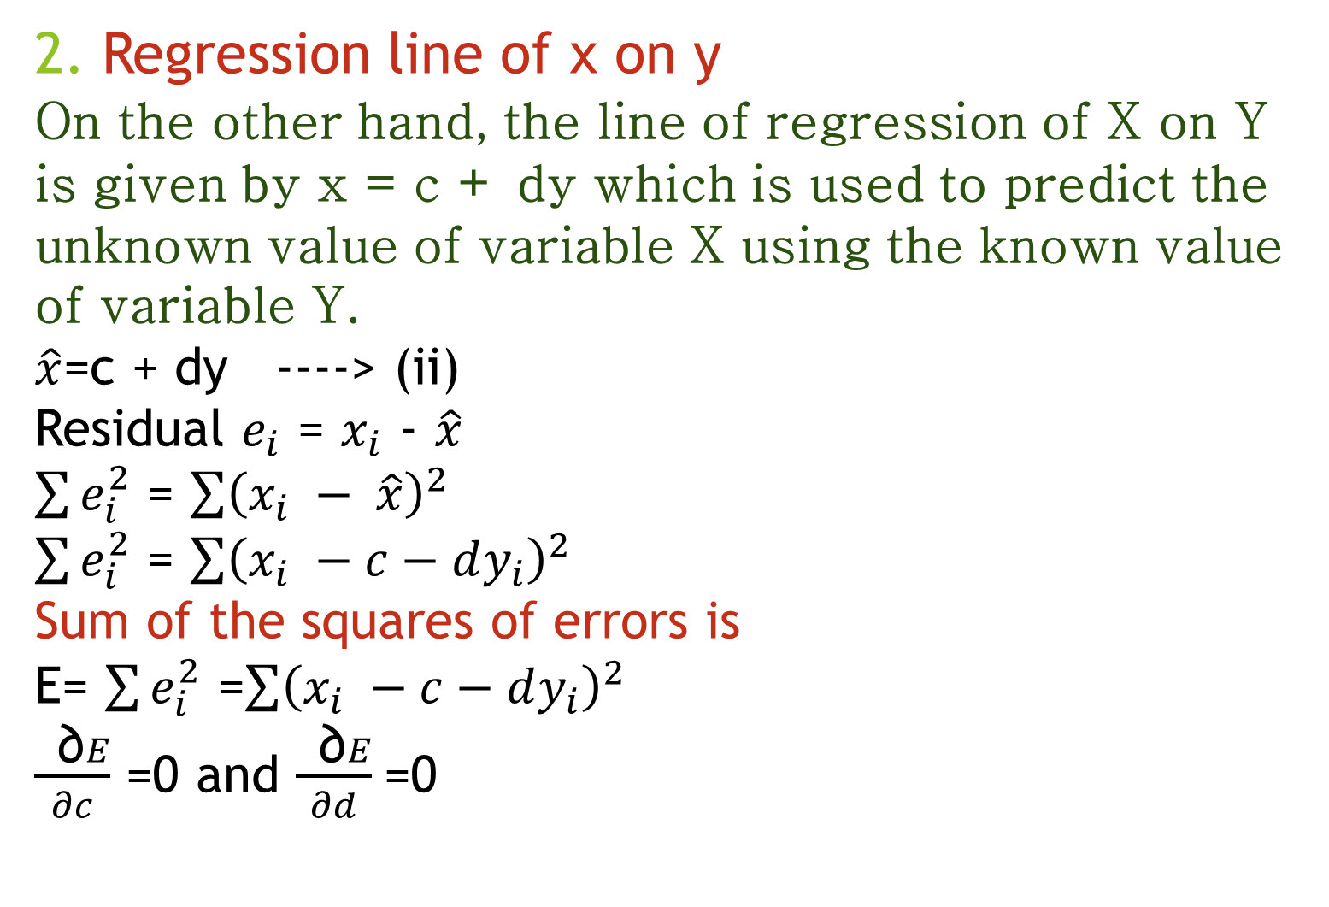
2. Regression line of x on y
On the other hand, the line of regression of X on Y is given by x = c + dy which is used to predict the unknown value of variable X using the known value of variable Y.
$\hat{x}$=c + dy ----> (ii)
Residual $e_{i}$ = $x_{i}$ - $\hat{x}$
$\sum{e_{i}^{2}}$ = $\sum{{\left(x_{i} − \hat{x}\right)}^{2}}$
$\sum{e_{i}^{2}}$ = $\sum{{\left(x_{i} −c−dy_{i}\right)}^{2}}$
Sum of the squares of errors is
E= $\sum{e_{i}^{2}}$ =$\sum{{\left(x_{i} −c−dy_{i}\right)}^{2}}$
$\frac{ \text{∂}E}{∂c}$ =0 and $\frac{ \text{∂}E}{∂d}$=0
X | Y
- | -
- | -
- | -
- | -
- | -

Slide 13
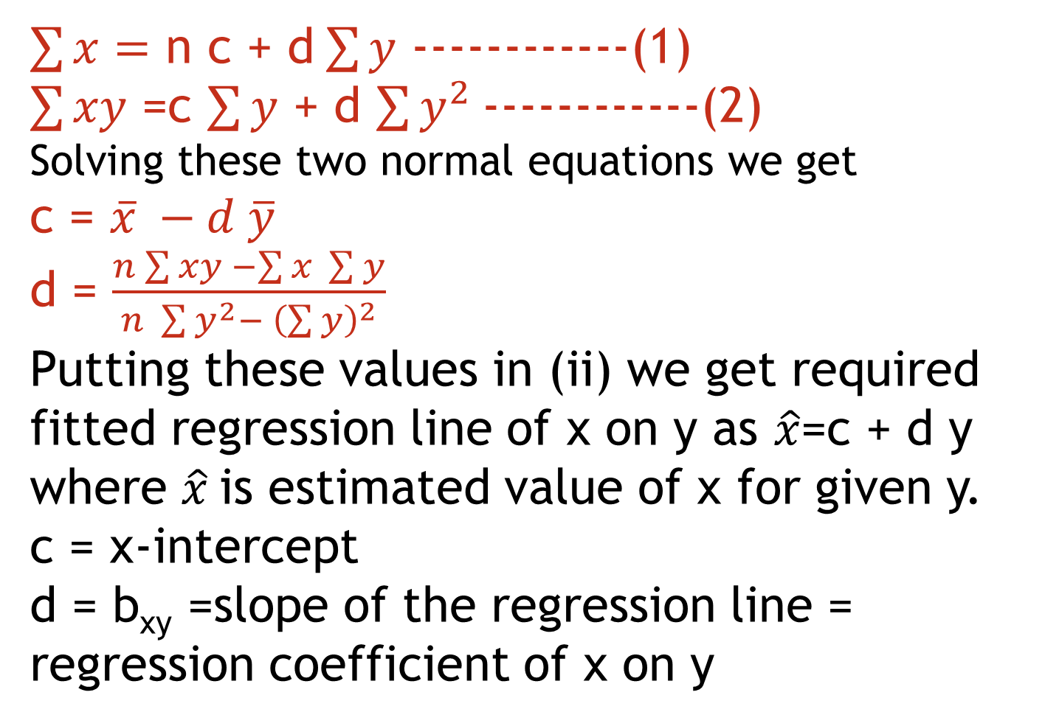
$\sum{x}=$ n c + d$\sum{y}$ ------------(1)
$\sum{xy}$ =c $\sum{y}$ + d $\sum{y^{2}}$ ------------(2)
Solving these two normal equations we get c = $\overline{x} −d \overline{y}$ d = $\frac{n\sum{xy −\sum{x \sum{y}}}}{n \sum{y^{2}}− {\left(\sum{y}\right)}^{2}}$
Putting these values in (ii) we get required fitted regression line of x on y as $\hat{x}$=c + d y where $\hat{x}$is estimated value of x for given y. c = x-intercept d = b_{xy} =slope of the regression line = regression coefficient of x on y

Slide 14
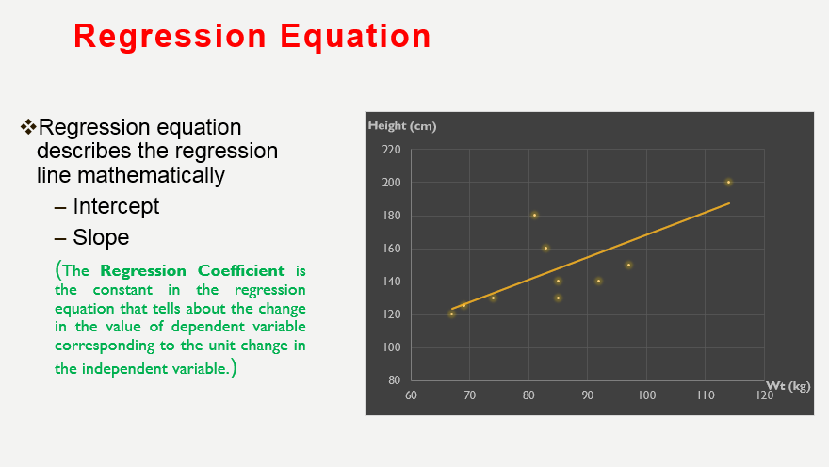

Slide 15
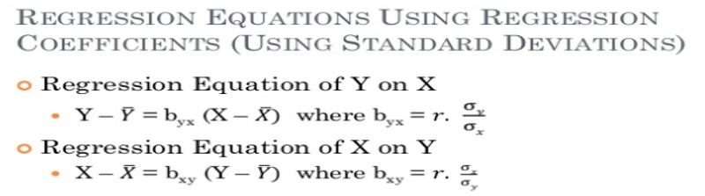

Slide 16
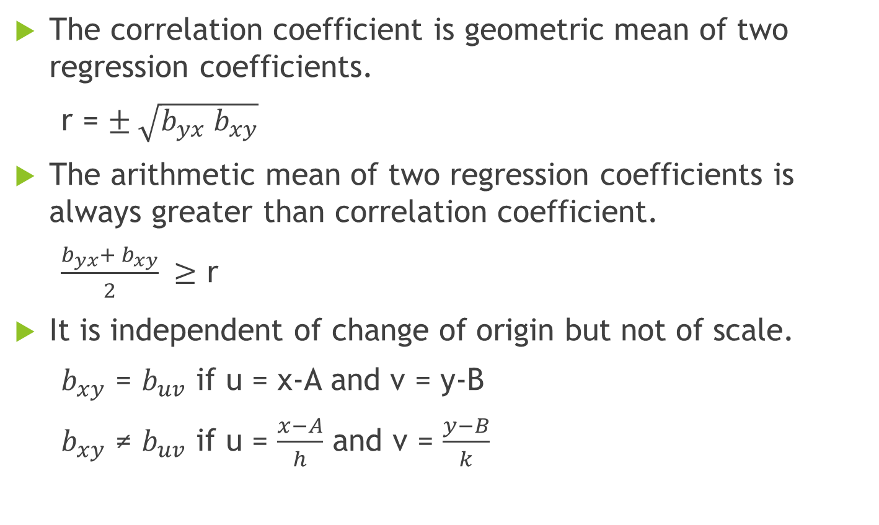
Properties of Regression Coefficient:
The correlation coefficient is geometric mean of two regression coefficients.
r = $± \sqrt{b_{yx} b_{xy}}$
The arithmetic mean of two regression coefficients is always greater than correlation coefficient.
$\frac{b_{yx}+ b_{xy}}{2} ≥$ r
It is independent of change of origin but not of scale.
$b_{xy}$ = $b_{uv}$ if u = x-A and v = y-B
$b_{xy}$ ≠ $b_{uv}$ if u = $\frac{x−A}{h}$ and v = $\frac{y−B}{k}$

Slide 17
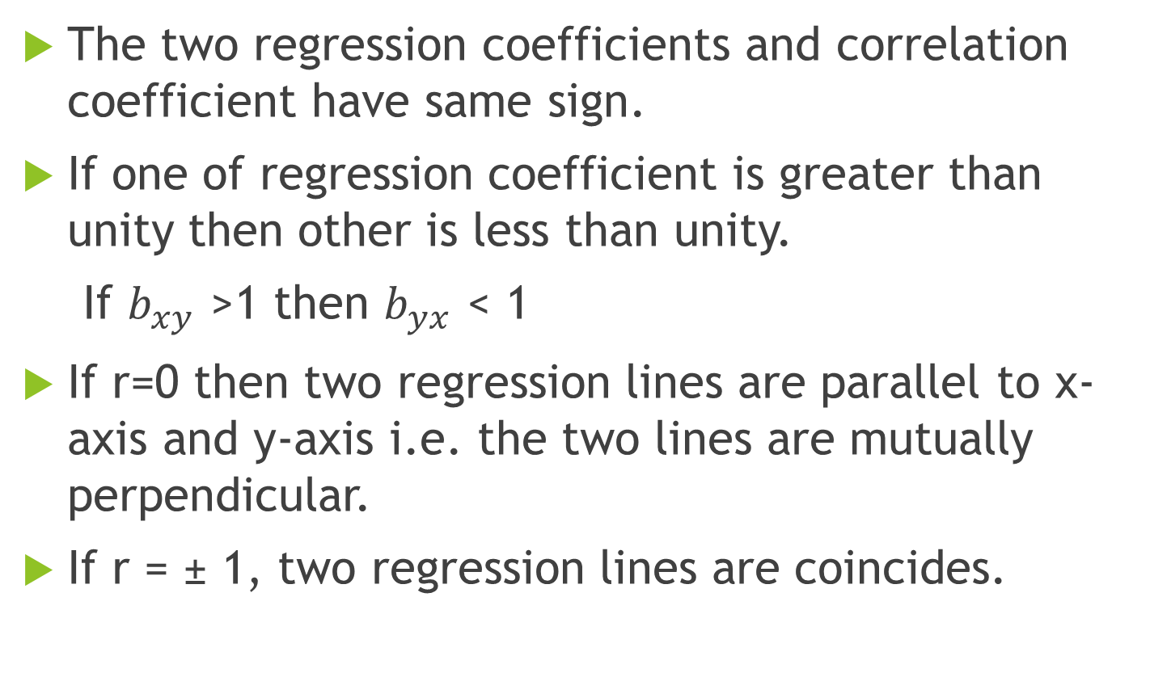
Properties of Regression Coefficient:
The two regression coefficients and correlation coefficient have same sign.
If one of regression coefficient is greater than unity then other is less than unity.
If $b_{xy}$ >1 then $b_{yx}$ < 1
If r=0 then two regression lines are parallel to x- axis and y-axis i.e. the two lines are mutually perpendicular.
If r = ± 1, two regression lines are coincides.

Slide 18
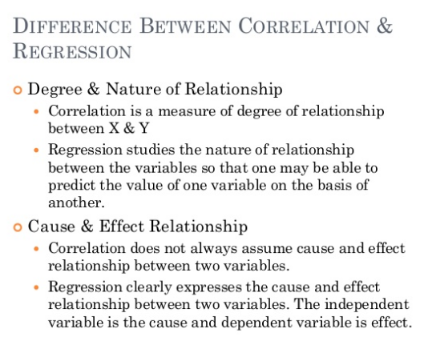

Slide 19
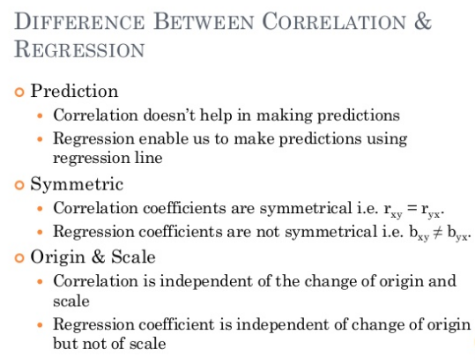

Slide 20
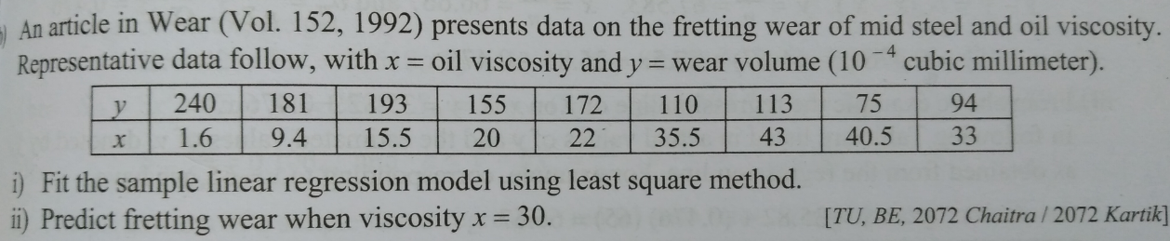

Slide 21
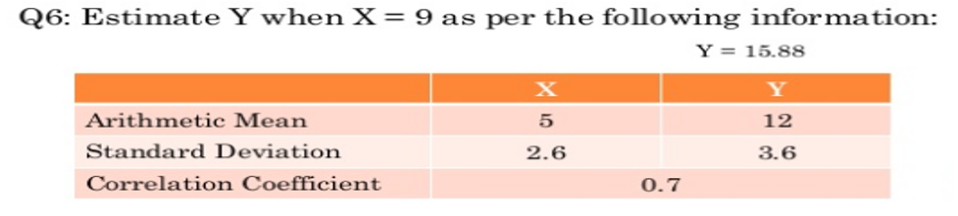

Slide 22
Multiple Regression:
The study of average form of relationship between one dependent variable and two or more independent variable is called multiple regression.
The regression plane of y on x₁ and x₂ is y=b₀ + b₁ x₁ +b₂ x₂

Slide 23
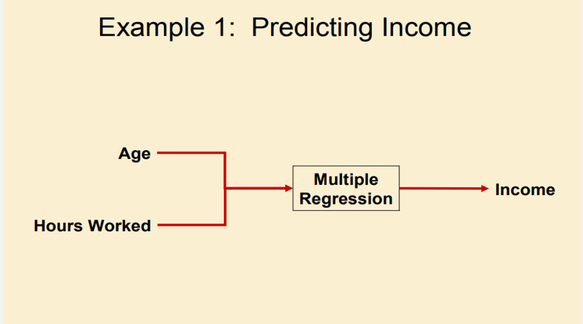

Slide 24
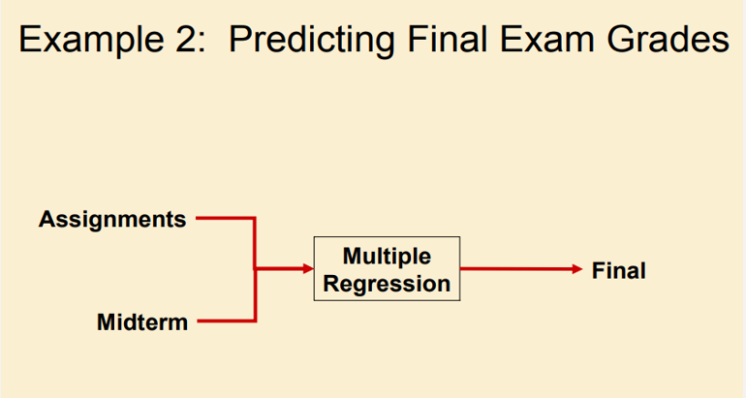

Slide 25
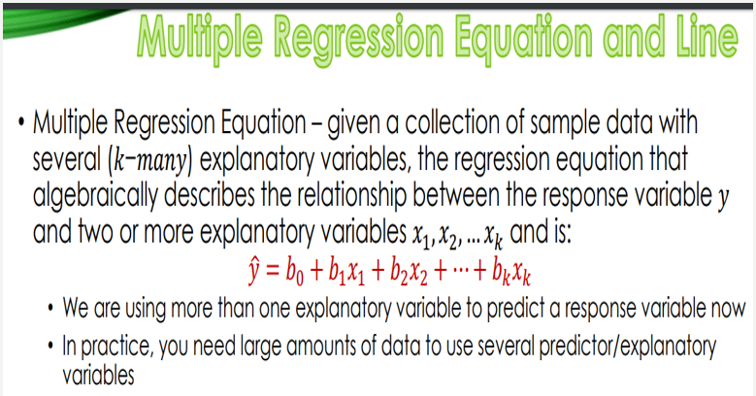

Slide 26
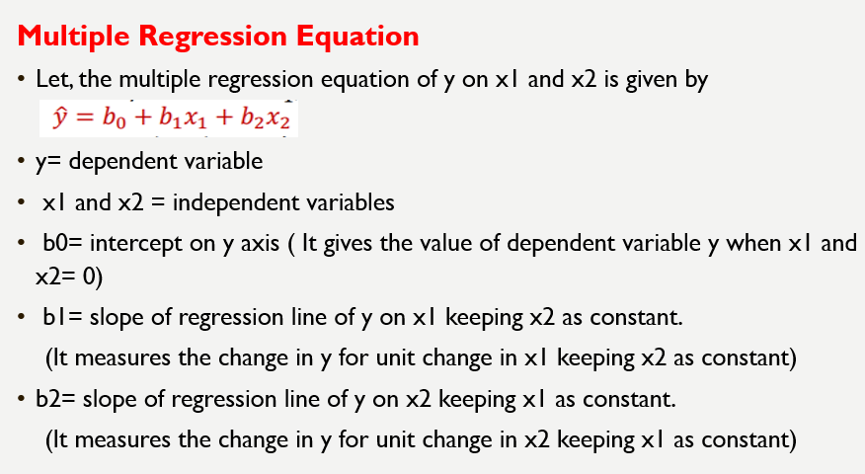

Slide 27
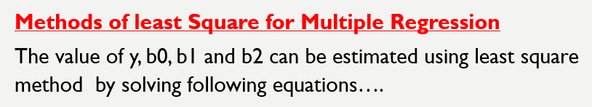
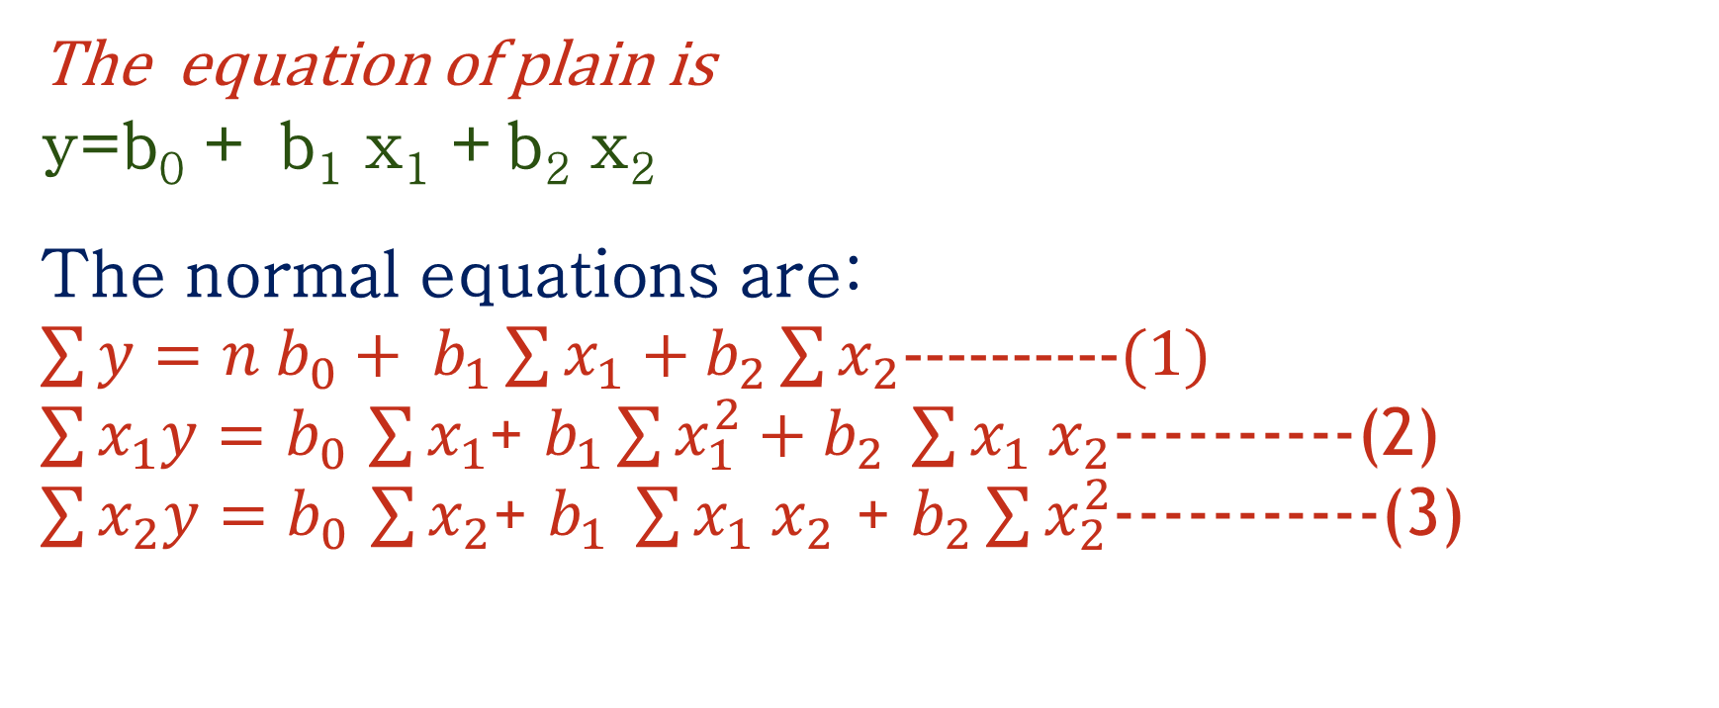
The equation of plain is y=b₀ + b₁ x₁ +b₂ x₂
The normal equations are:
$\sum{y=n b_{0}+ b_{1}}\sum{x_{1}}+b_{2}\sum{x_{2}}$----------(1)
$\sum{x_{1}y=b_{0}}$ $\sum{x_{1}}$+ $b_{1}\sum{x_{1}^{2}+b_{2} \sum{x_{1} x_{2}}}$----------(2)
$\sum{x_{2}y=b_{0}}$ $\sum{x_{2}}$+ $b_{1} \sum{x_{1} x_{2}}$ + $b_{2}\sum{x_{2}^{2}}$-----------(3)

Slide 28
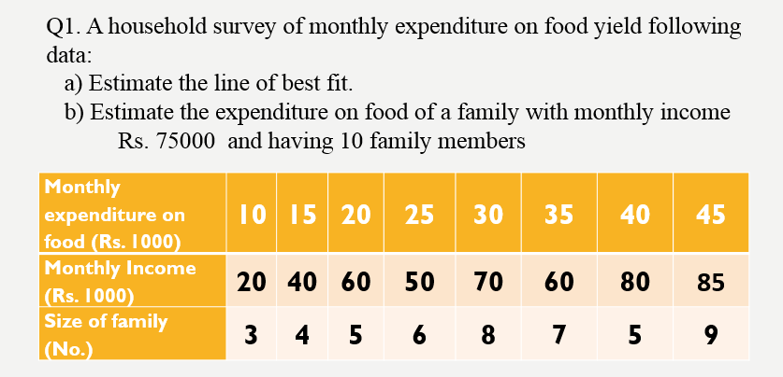

Slide 29
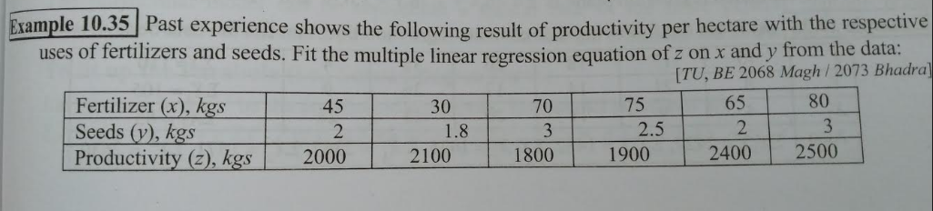

Slide 30
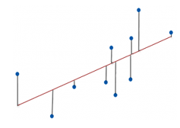
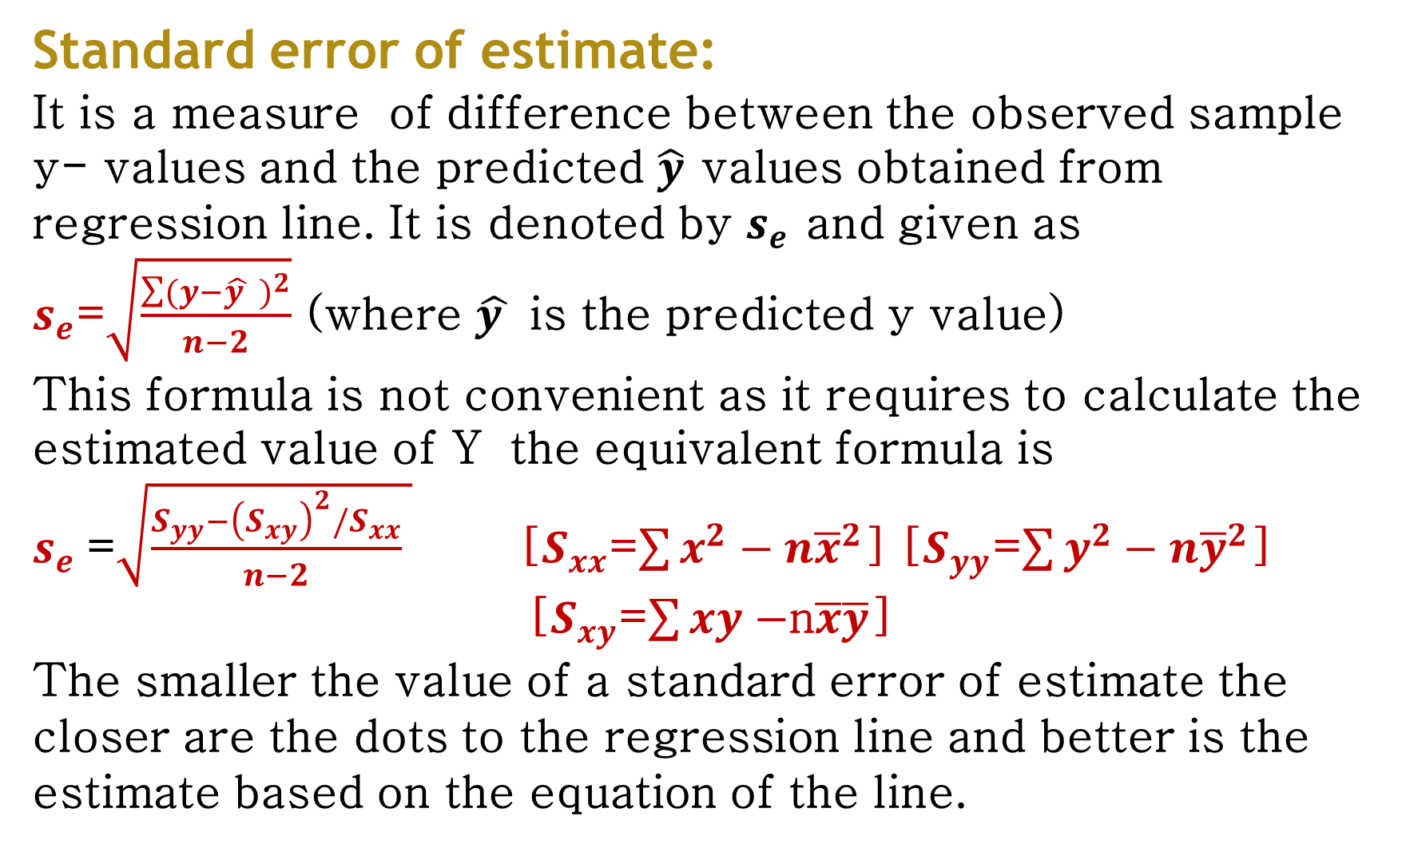
Standard error of estimate:
It is a measure of difference between the observed sample y- values and the predicted $\hat{y}$ values obtained from regression line. It is denoted by $s_{e}$ and given as
$s_{e}$=$\sqrt{\frac{\sum{{(y−\hat{y } )}^{2}}}{n−2}}$ (where $\hat{y }$ is the predicted y value)
This formula is not convenient as it requires to calculate the estimated value of Y the equivalent formula is
$s_{e}$=$\sqrt{\frac{S_{yy}−{\left(S_{xy}\right)}^{2}/S_{xx}}{n−2} }$ [$S_{xx}$=$\sum{x^{2}}−{n\overline{x}}^{2}$] [$S_{yy}$=$\sum{y^{2}}−{n\overline{y}}^{2}$]
[$S_{xy}$=$\sum{xy}−$n$\overline{x}\overline{y}$]
The smaller the value of a standard error of estimate the closer are the dots to the regression line and better is the estimate based on the equation of the line.

Slide 31
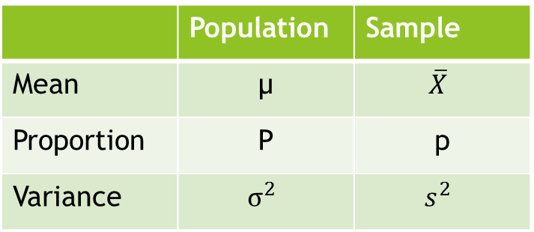
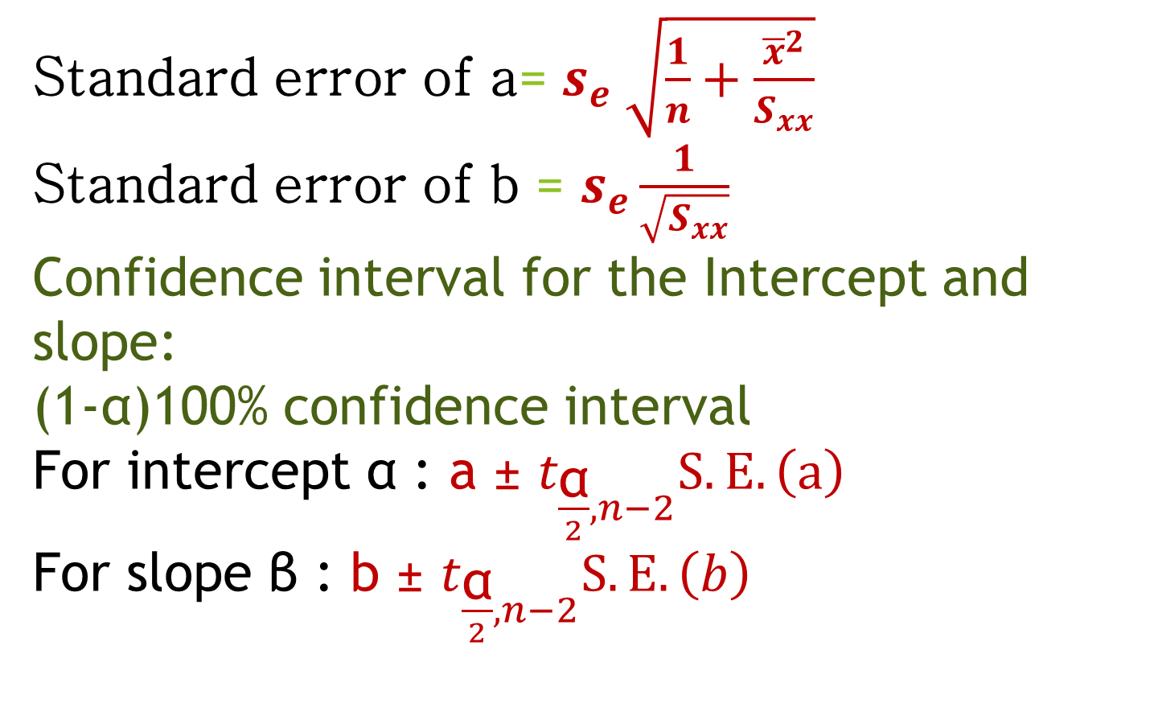
Standard error of a= $s_{e} \sqrt{\frac{1}{n}+\frac{{\overline{x}}^{2}}{S_{xx}}}$
Standard error of b = $s_{e}\frac{1}{\sqrt{S_{xx}}}$
Confidence interval for the Intercept and slope:
(1-α)100% confidence interval
For intercept α : a ± $t_{\frac{\text{α}}{2},n−2}S.E.\left(a\right)$
For slope β : b ± $t_{\frac{\text{α}}{2},n−2}S.E.\left(b\right)$
 | Intercept | Slope
Population | α | β
Sample | a | b
 | Population | Sample
Mean | µ | $$\overline{X}$$
Proportion | P | p
Variance | $$σ^{2}$$ | $$s^{2}$$

Slide 32
Problem 2:
Ten steel wires of diameter 0.5 mm and length 2.5m were extended in a laboratory by applying vertical forces of varying magnitudes. Results are as follows: a) Estimate the parameters of a simple linear regression model with force as the explanatory variable. b) find 95% confidence interval for the intercept and slope of the line.
Force (kg) x | 15 | 19 | 25 | 35 | 42 | 48 | 53 | 56 | 62 | 65
Increase in length (mm) y | 1.7 | 2.1 | 2.5 | 3.4 | 3.9 | 4.9 | 5.4 | 5.7 | 6.6 | 7.2

